Slide 1
Reconstruction of momentum density and determination of one-electron reduced density matrix
NNT : 2018SACLC001
Zeyin YAN
Membres du Jury:
Rapporteur | Dr. Carlo Gatti | University of Milan
Rapporteur | Pr. Enrique Espinosa | Université de Lorraine
Examinateur | Pr. Claude Lecomte | Université de Lorraine
Examinateur | Pr. Nour-Eddine Ghermani | Université Paris-Sud
Examinatrice | Dr. Béatrice Gillon | CNRS, LLB (CEA -Saclay)
Examinateur | Dr. Alessandro Erba | University of Torino
Directeur de thèse | Pr. Jean-Michel Gillet | CentraleSupélec

Slide 2
Overview
Introduction
1. Electron densities in position and momentum spaces
Position space representations
Momentum space representations
‘‘Super-position’’ construction
2. Periodic 1-RDM by a cluster construction
Cluster construction
Phase space functions
Orbital resolved 1-RDM
3. Experimental 1-RDM refinement
Refinement model
Results
Conclusions and perspectives
Notes:
Short introduction
1, 2, 3
Conclusions…

Slide 3
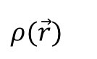
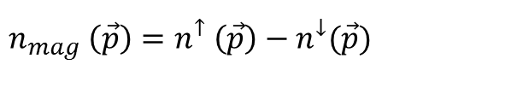
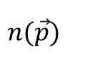
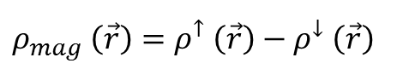
Electron density
Introduction
Electron density is a key for understanding the material properties
position
$$ρ(\vec{r})$$
position
$$ρ_{mag} \left(\vec{r}\right)=ρ^{↑} \left(\vec{r}\right)−ρ^{↓} \left(\vec{r}\right)$$
charge
spin
momentum
$$n(\vec{p})$$
momentum
$$n_{mag} \left(\vec{p}\right)=n^{↑} \left(\vec{p}\right)−n^{↓}(\vec{p})$$
Ab-initio computations
Hartree-Fock (HF) : wave-functions
Density functional theory (DFT) : Kohn-Sham orbitals^{[1]}
Molecular or periodic computations
[1] Stowasser. R., & Hoffmann. R. (1999).

Slide 4
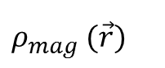
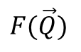
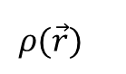
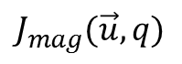
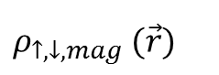
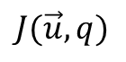
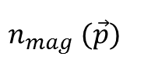
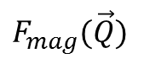
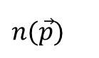
Electron density
Introduction
Experimental observations
Electron
densities
$$ρ(\vec{r})$$
$$ρ_{mag} (\vec{r})$$
$$n(\vec{p})$$
$$n_{mag} (\vec{p})$$
Refinement
models
Maximum entropy method
(model free)
Independent atoms model
Hansen-Coppens model
…
Maximum entropy method
(model free)
Atomic orbital model
Hansen-Coppens model
…
Reconstruction method
(model free)
…
Reconstruction method
(model free)
…
Techniques
X ray diffraction
(XRD)
Polarized neutron diffraction
(PND)
Compton scattering
(CS)
Magnetic Compton scattering
(MCS)
Observations
$$F(\vec{Q})$$
$$F_{mag}(\vec{Q})$$
$$J(\vec{u},q)$$
$$J_{mag}(\vec{u},q)$$
Joint
refinement
‘spin-split’ model^{[1,2]}
$$ρ_{↑,↓,mag} (\vec{r})$$
position space
momentum space
The whole is more than the sum of its parts^{[3]}
[1] Deutsch, M. et al., 2012
[2] Deutsch, M. et al., 2014
[3] Macchi, P. et al., 2015
Joint models??

Slide 5
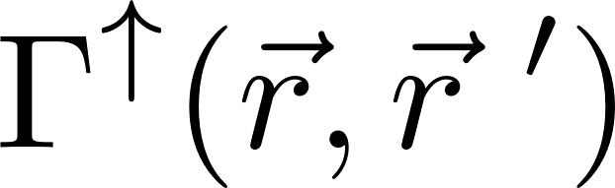
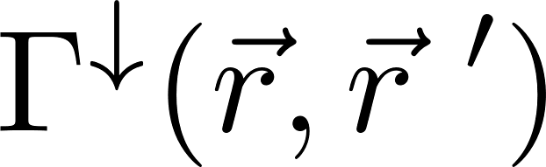
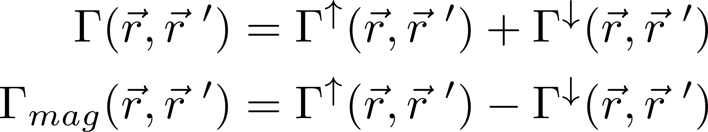
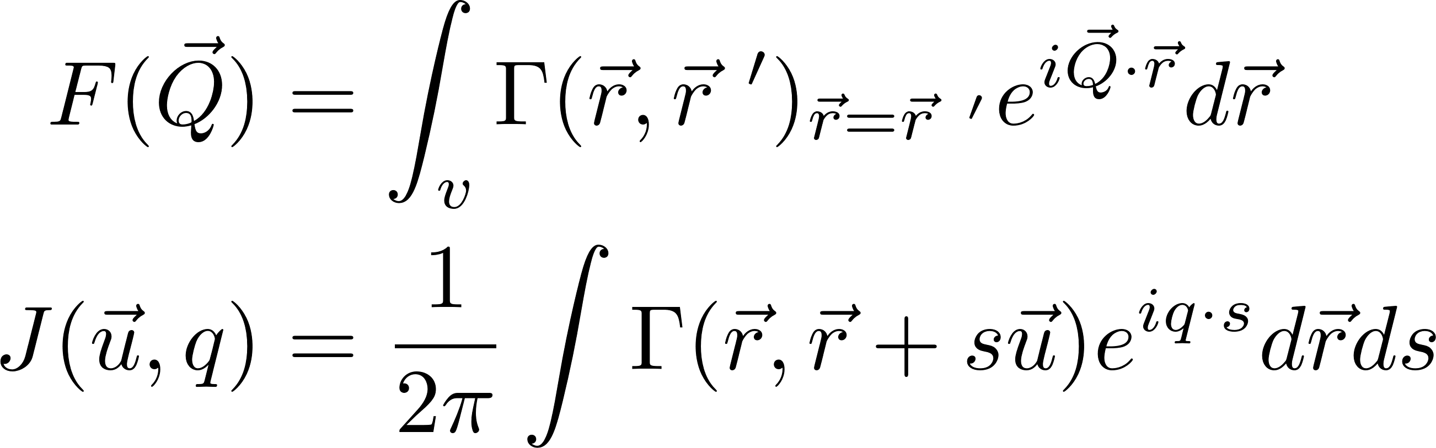
1-RDM
Introduction
One-electron Reduced Density Matrix (1-RDM)^{[1]}
Spin-resolved 1-RDM
Connection with position and momentum spaces
Diagonal
Off-diagonal
--
--
position
momentum
1-RDM is a natural quantity to connect both position and momentum spaces
[1] Löwdin. P. O. (1955).

Slide 6
Objectives
Introduction
Electron density research in position and momentum spaces
Coherence between different experimental data (qualitative)
Experimental 1-RDM refinement (quantitative)
Theoretical 1-RDM computation for periodic case
Notes:
Qualitative
Quantitative

Slide 7
Overview
Introduction
Electron densities in position and momentum spaces
Position space representations
Momentum space representations
‘‘Super-position’’ construction
Periodic 1-RDM by a cluster construction
Cluster construction
Phase space functions
Orbital resolved 1-RDM
Experimental 1-RDM refinement
Refinement model
Results
Conclusions and perspectives

Slide 8
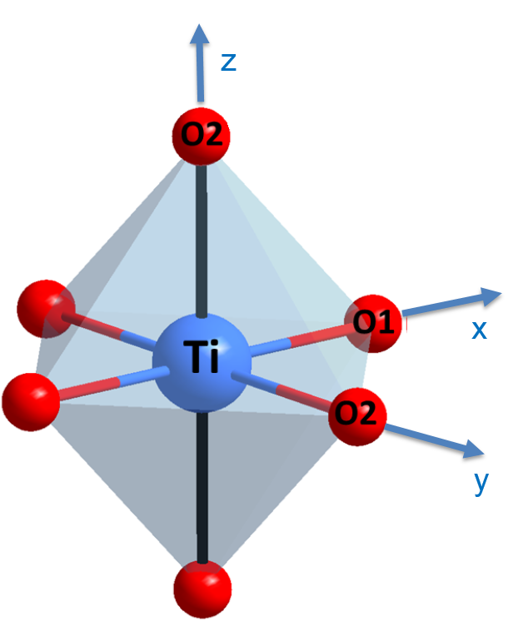
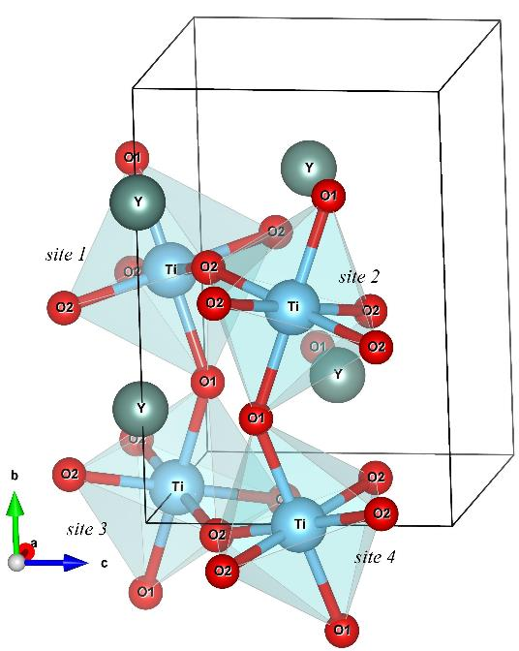
YTiO₃ perovskite
YTiO₃
Ferromagnetic below T_{c}=29K
Space group: Pnma
TiO₆ octahedra
O2
’
2.08 Å
2.024 Å
O1
2.025 Å
O2
2.08 Å
2.025 Å
Ti—O₂’
O₂—Ti
Notes:
Most importantly, this crystal is stable for XRD, PND and MCS
O2 and O2’

Slide 9

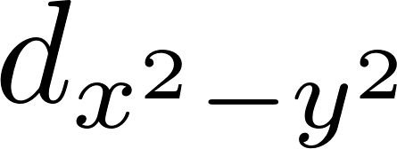
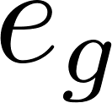
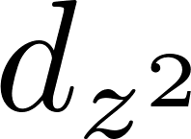
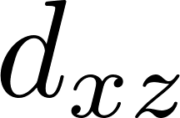
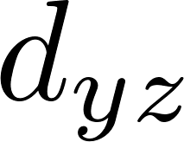
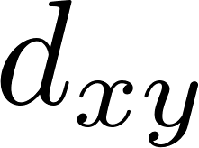
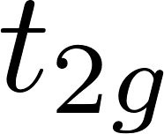
3d-orbital splitting
YTiO₃
Ti 3d-orbital splitting due to crystal field
O2
E
’
2.08 Å
Ti 3d-orbital
2.024 Å
O1
2.025 Å
O2
octahedron field
elongation along z
Akimitsu. J, et al (2001).
Notes:
Due to the crystal field effect
Confirmed by Akimitsu with PND data

Slide 10

Ti—O—Ti spin coupling
YTiO₃
Spin coupling pathways
Ti(3d)—O(2p)—Ti(3d) spin coupling
Ti—O₁—Ti
2.024 Å
2.024 Å
Ti—O₂—Ti
2.08 Å
2.025 Å
Ti—O₂’
O₂—Ti
Respective roles of O₁ and O₂ need to be clarified
Notes:
In O1 case, two Ti atoms on both sides are at the same distances

Slide 11
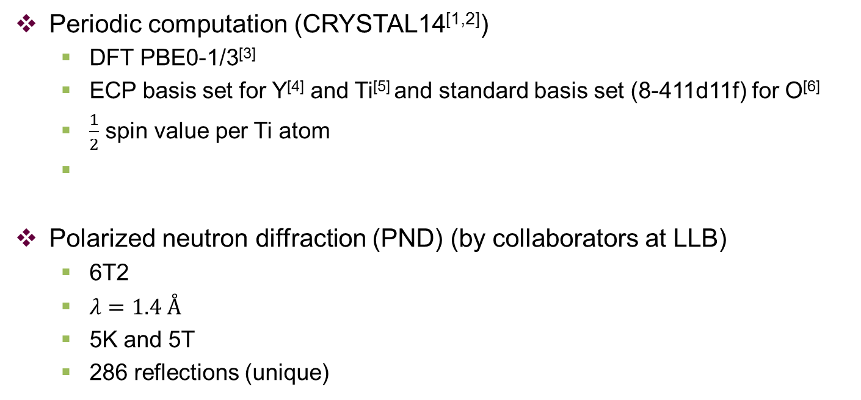
Basic knowledge
Electron density in position space
Periodic computation (CRYSTAL14^{[1,2]})
DFT PBE0-1/3^{[3]}
ECP basis set for Y^{[4]} and Ti^{[5]} and standard basis set (8-411d11f) for O^{[6]}
$\frac{1}{2}$ spin value per Ti atom
Polarized neutron diffraction (PND) (by collaborators at LLB)
6T2
$λ=1.4 Å$
5K and 5T
286 reflections (unique)
[1] Dovesi. R, et al (2014).
[2] Dovesi. R, et al, CRYSTAL14 User's Manual (2014).
[3] Guido, C. A. et al (2013).
[4] unpublished data, offered by the CRYSTAL14 site http://www.crystal.unito.it/Basis_Sets/yttrium.html
[5] Piskunov, S. et al (2004).
[6] Erba, A. et al (2013).

Slide 12
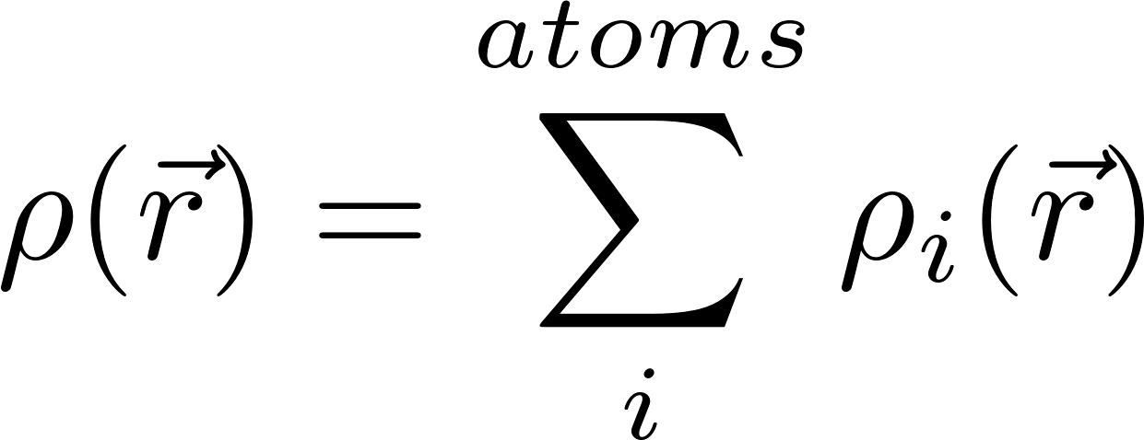
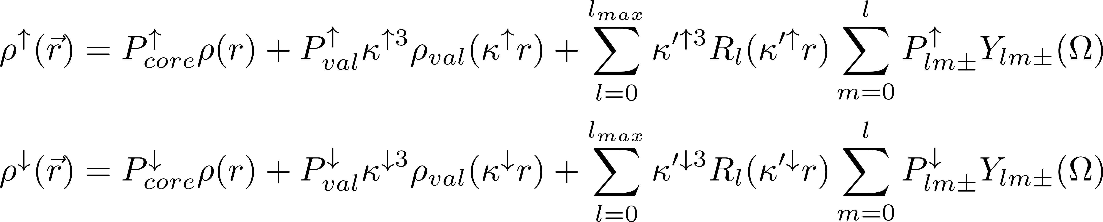
Refinement models
Electron density in position space
Hansen-Coppens model^{[1]}
Spherical core
Spherical valence
Deformation valence
‘‘Spin split’’ model^{[2]}
[1] Hansen & Coppens (1978).
[2] Deutsch et al (2012).

Slide 13
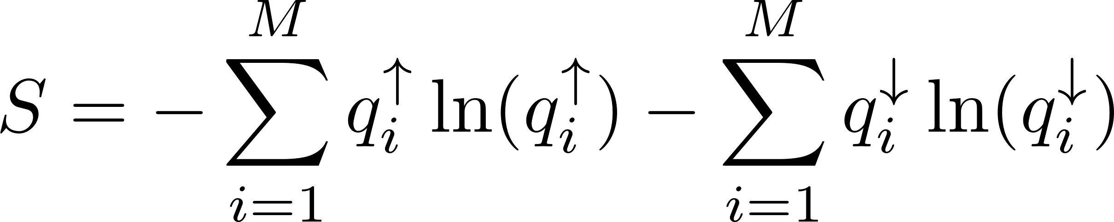
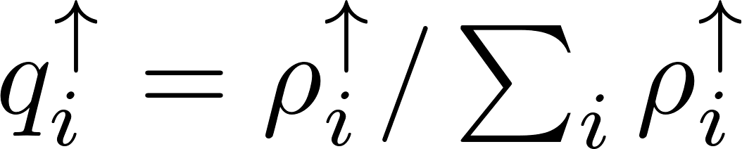
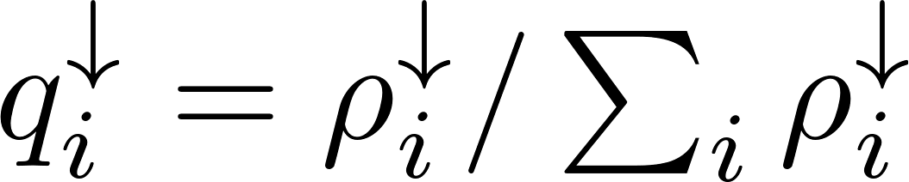
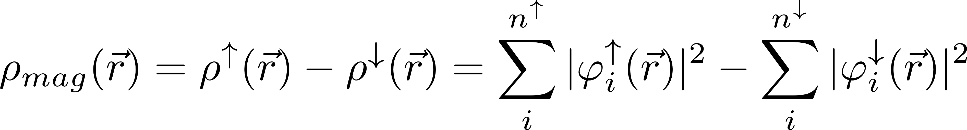
Refinement models
Electron density in position space
Maximum entropy method (MEM)^{[1]}
Atomic orbital model^{[2]}
MEM and atomic orbital model results will be presented
[1] Papoular, R. J., & Gillon, B. (1990).
[2] Gillon, B., & Becker, P. (2011).
MEM and atomic orbital model refinements are conducted by I. A. Kibalin and collaborators at LLB
Joint refinement results will be presented in the thesis of Voufack, A. B. (PhD student at CRM2)
Notes:
Entropy is the sum of entropy up and down

Slide 14
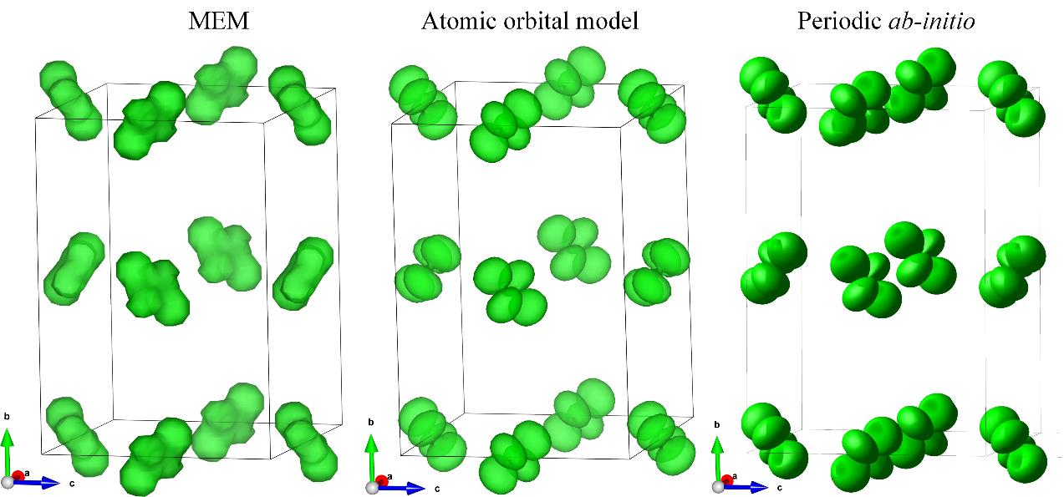
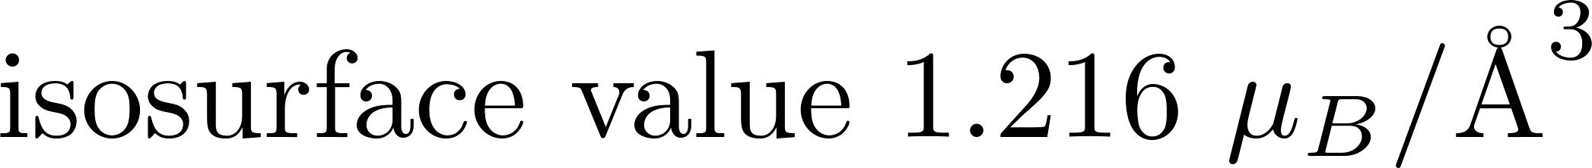
Results
Electron density in position space
Atomic orbital model Ti 3d-orbital (PND)

Slide 15

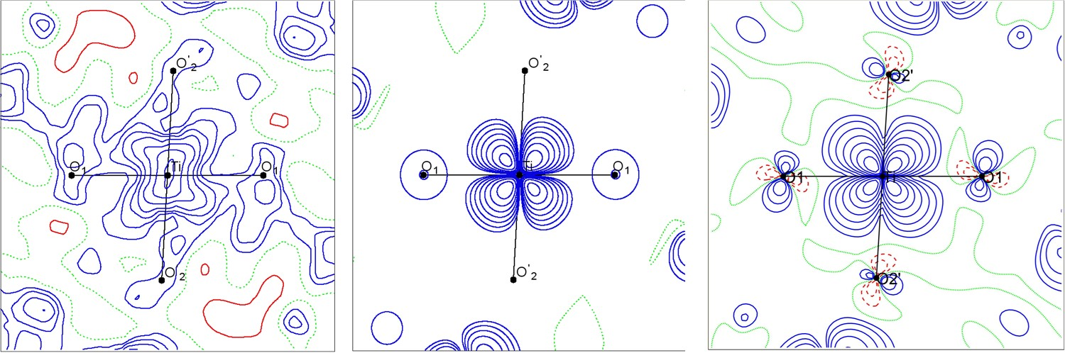
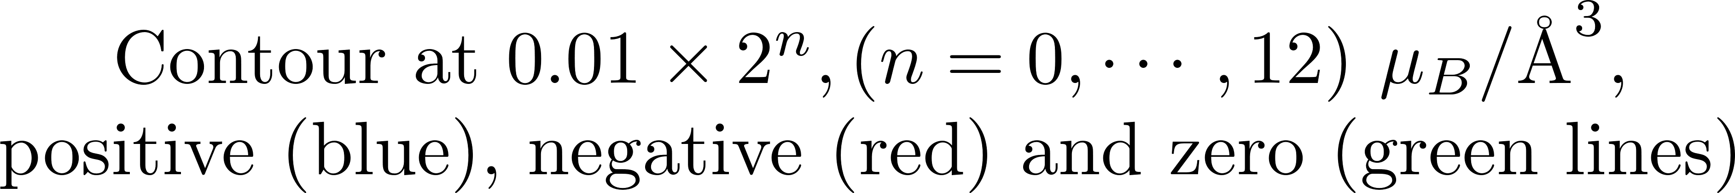
Results
Electron density in position space
O2
’
Spin density in O₁—Ti—O₂’ plane
O1
O2
MEM
Atomic orbital model
Periodic ab-initio
Notes:
Only spherical functions defined for O1 in refinement model

Slide 16
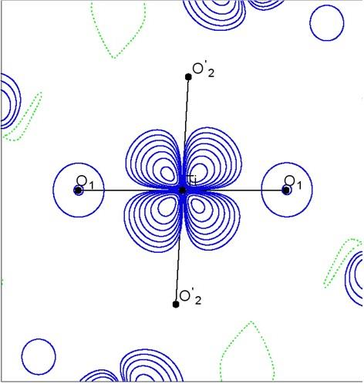
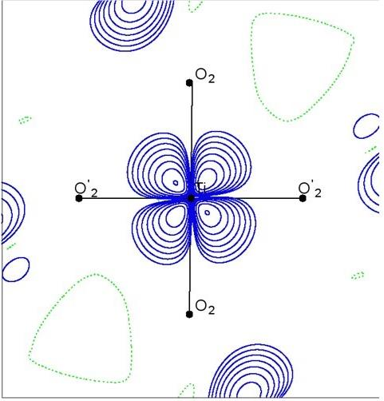
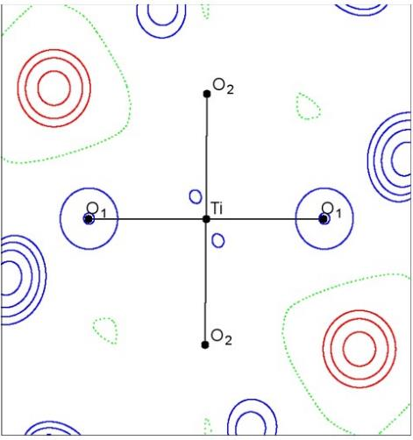
Results
Electron density in position space
O2
’
Spin density by atomic orbital model
O1
PND:
O2
O₁—Ti—O₂’
O₂—Ti—O₂’
O₁—Ti—O₂
Local axes:
xz
yz
xy

Slide 17
Overview
Introduction
Electron densities in position and momentum spaces
Position space representations
Momentum space representations
‘‘Super-position’’ construction
Periodic 1-RDM by a cluster construction
Cluster construction
Phase space functions
Orbital resolved 1-RDM
Experimental 1-RDM refinement
Refinement model
Results
Conclusions and perspectives

Slide 18
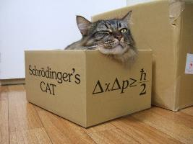
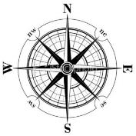

Momentum space
Electron density in momentum space
N(v//)
v//
N(v⏊)
v⏊

Slide 19
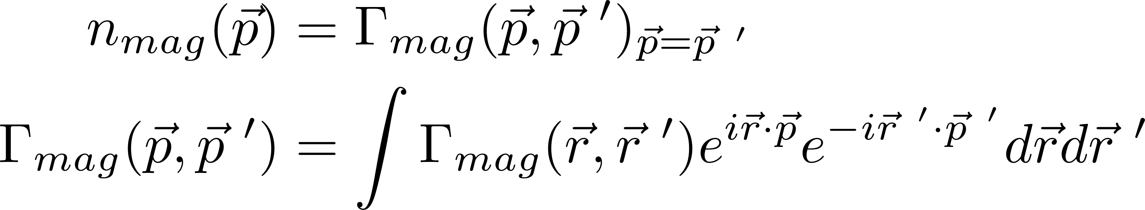
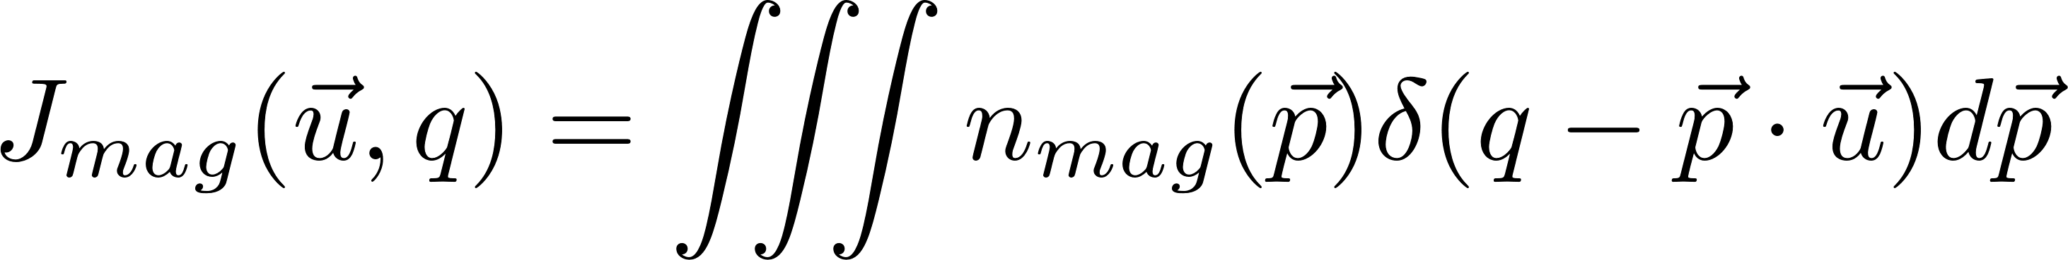
Basic knowledge
Electron density in momentum space
Theoretical computation
Directional magnetic Compton profiles (DMCPs)
Magnetic Compton scattering (MCS) (conducted at Spring8)
BL08W
2.5T
10K ~ 18K
resolution 0.4 a.u.
12 directions (3 principal axes + 3 in each plane)
(data was treated by M. Brancewicz)
b
a
c

Slide 20
DMCPs
Electron density in momentum space
DMCPs in (ac) plane
Theoretical DMCPs
convoluted with experimental resolution
Theoretical DMCPs
Experimental DMCPs
Gaussian filter is used for convolution

Slide 21
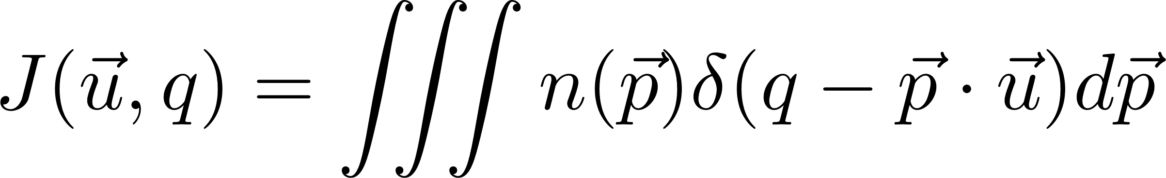
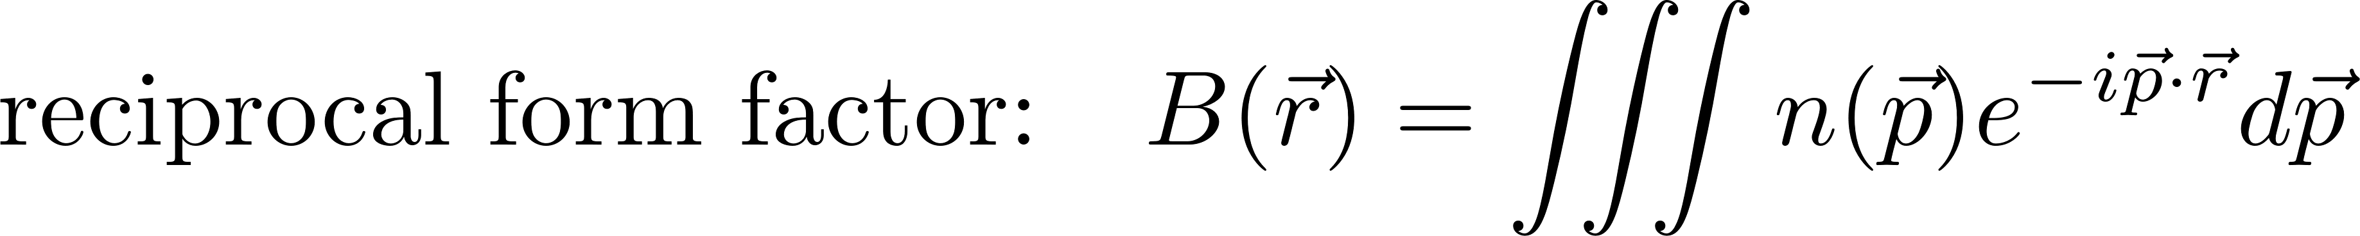
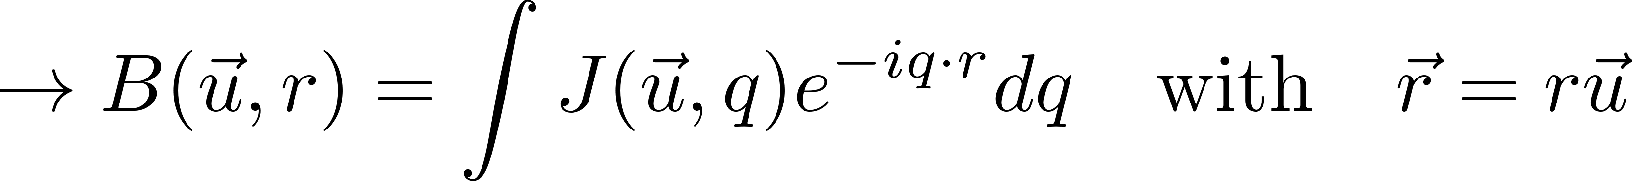
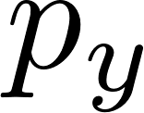


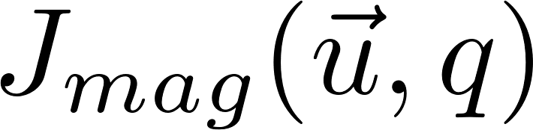
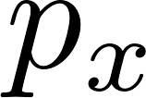



Two-dimensional reconstruction
Electron density in momentum space
Since
Two-dimensional reconstruction method^{[1]}
Interpolation
FFT
IFFT
[1] Tanaka, Y., Sakurai, Y, et al (2001).

Slide 22




2D-MEMD
Electron density in momentum space
Two-dimensional magnetic electron momentum density (2D-MEMD)
(ac) plane
Theoretical (convoluted)
Experimental

Slide 23




Anisotropy
Electron density in momentum space
(ac) plane
Theoretical (convoluted)
Experimental
Primitive cell:
340 electrons 4 unpaired electrons (less than 2%)

Slide 24







Error analysis
Electron density in momentum space
Error propagation analysis
$$\{σ(J(\vec{u},q_{i}))\}$$
Computation N times
Compton Scattering
Generate random $J(\vec{u},q_{i})$ from Gaussian distribution
$$\{J^{random}(\vec{u},q_{i})\}$$
$$\{J(\vec{u},q_{i})\}$$
Normalization
$$\{J^{′}(\vec{u},q_{i})\}$$
$$\{n(\vec{p})\}$$
$$\{σ_{n(\vec{p})}\}$$
Reconstruction
Statistical analysis

Slide 25




Error analysis
Electron density in momentum space
Propagated error
(ac) plane with N=1000
$$σ_{n_{mag}(\vec{p})}$$
$$n_{mag}(\vec{p})$$
Notes:
Our 2D reconstruction gives a good quality result

Slide 26







‘‘Super-position’’
‘Super-position’ construction
An qualitative method to connect position and momentum spaces
Coherence ?
2D-
’super-position’ spin density
(ac) plane
b
b
c
c
a
a
3D spin density
Position space
2D-MEMD
Momentum space
Theoretical
Experimental

Slide 27
‘‘Super-position’’
‘Super-position’ construction
(ac) plane
Cross-checking between PND and MCS
2D-‘‘super-position ’’ spin density
(Position space)
2D-MEMD
(Momentum space)
Geometric similarity between position and momentum results
Limitation: a single type of atom is responsible for a major part of spin density
Notes:
It works better for the crystal where a single …
For YTiO3 case, the major spin contribution comes from Ti atom

Slide 28













Isolated Ti model
Isolated Ti model
PND 3d-orbital (atomic orbital model)
Reproduction of 2D-’super-position’ spin density
Calculation of 2D-MEMD
2D-‘‘super-position’’ spin density:
(ab)
(ac)
(bc)
2D-MEMD:
(ab)
(ac)
(bc)
Ti—O₁
Ti—O₂
MCS construction
Ti and O construction
Isolated Ti Model
Ti—O₁—Ti is a possible spin coupling pathway
Notes:
So the simplest model we can consider is the one

Slide 29
Overview
Introduction
Electron densities in position and momentum spaces
Position space representations
Momentum space representations
‘‘Super-position’’ construction
Periodic 1-RDM by a cluster construction
Cluster construction
Phase space functions
Orbital resolved 1-RDM
Experimental 1-RDM refinement
Refinement model
Results
Conclusions and perspectives

Slide 30
Motivations
Periodic 1-RDM
Capacity of gathering position and momentum spaces
Diagonal -- position
Off-diagonal -- momentum
Computational challenges
1-RDM
Phase space functions
Cross-term analysis

Slide 31



Cluster construction
Periodic 1-RDM
Periodic ab-initio computation
(CRYSTAL 14)
The primitive cell is where we want to calculate the properties
Contributions from all the 26 first neighboring cells around are accounted for
A cluster of 27 cells (a Rubik’s magic cube) is extracted from the periodic computation

Slide 32



Validation
Periodic 1-RDM
In position space
CRYSTAL 14
27-cell cluster construction
Difference

Slide 33




Validation
Periodic 1-RDM
In momentum space
CRYSTAL 14
Difference
27-cell cluster construction
Reproduction both in position and momentum spaces by cluster construction

Slide 34











1-RDM
Periodic 1-RDM
Ti—O₁—Ti
Ti—O₂—Ti
2.025 Å
2.024 Å
2.024 Å
2.08 Å
: cross-term between two atoms
Difference between O₁ and O₂ can be clarified by 1-RDM

Slide 35














Cross-term analysis
Periodic 1-RDM
Regroup the orbitals
: atomic orbitals
If A and B are the same atom,
the result is atomic contribution
If A and B are different atoms,
the result is cross-term contribution
Notes:
more specifically, TiO1 and TiO2

Slide 36



Cross-term analysis
Periodic 1-RDM
In position space:
Weakness of cross-term contribution confirms the legitimacy of refinement model in position space

Slide 37




Cross-term analysis
Periodic 1-RDM
Ti—O₁—Ti
Ti—O₂—Ti
In momentum space:
Different behaviors for TiO1 and TiO2
Notes:
Basin: O1 83.869, O2 84.145

Slide 38



Cross-term analysis
Periodic 1-RDM
Ti—O₁—Ti
Ti—O₂—Ti
1-RDM:
2.025 Å
2.024 Å
2.024 Å
2.08 Å
Cross-term
Cross-term
Cross-term is as important as atomic contribution in 1-RDM representation

Slide 39
Overview
Introduction
Electron densities in position and momentum spaces
Position space representations
Momentum space representations
‘Super-position’ construction
Periodic 1-RDM by a cluster construction
Cluster construction
Phase space functions
Orbital resolved 1-RDM
Experimental 1-RDM refinement
Refinement model
Results
Conclusions and perspectives
Notes:
Now that we have an ab-initio 1-RDM, the question that naturally arises is how it compares with an experimental 1-RDM, especially in O1 cross-term regions.
Here are the preliminary results of our attempts to define a refinement strategy

Slide 40





1-RDM refinement model
Experimental 1-RDM
Cluster approach:
O
O
O
O
₁
₁
₁
₁
: point charge at nuclei positions
S. Gueddida, Z. Yan, J. M. Gillet, Acta Crystallographica Section A: Foundations and Advances. (2017) (accepted)
S. Gueddida, Z. Yan, J. M. Gillet,." Physical Chemistry Chemical Physics. (2018) (submitted)
Notes:
As a minimal model to account for O1 coupling, two neighboring Ti and point charges

Slide 41

1-RDM refinement model
Experimental 1-RDM
Basis set optimization (only radial functions):
Gaussian type orbitals (GTOs):
Hansen-Coppens:
P. Becker & P. Coppens. Acta Cryst. (1985).

Slide 42











1-RDM refinement model
Experimental 1-RDM
Molecular occupation refinement:
CASSCF-like method:
Virtual
Unoccupied
Active
Fermi level
Active
Occupied
Core
optimized orbitals
refined orbitals
SCF orbitals
CASSCF orbitals
CASSCF: Complete active space self-consistent field

Slide 43






1-RDM refinement model
Experimental 1-RDM
Gas phase
ab-initio calculation
Process
Gas phase
ab-initio calculation
Compute $F_{mag}^{cal}(\vec{Q})$ and $J_{mag}^{cal}(\vec{u}, q)$
Basis set optimization
Energy minimization
Minimization of $L_{1}$
NO
$$α=α_{0}ξ$$
YES
Compute $F_{mag}^{cal}(\vec{Q})$ and $J_{mag}^{cal}(\vec{u}, q)$
Minimization of $L_{2}$
NO
$$n_{i}^{mag}=n_{i,0}^{mag}+δn_{i}^{mag}$$
Occupation refinement
YES
Convergence
Algorithm is implemented by S. Gueddida

Slide 44


1-RDM refinement model
Experimental 1-RDM
Application on YTiO₃
Gas phase ab-initio calculation is conducted with Gaussian 09, using HF/6-31G
Point charge values: CRYSTAL 14 TOPOND analysis
Theoretical $F_{mag}^{}(\vec{Q})$ and $J_{mag}^{}\left(\vec{u}, q\right)$ (with CRYSTAL 14) with adding noisy are used as “pseudo experimental observations”
1-RDM by Cluster construction is used as reference (CRYSTAL 14)
Only Ti—O₁—Ti 1-RDM is compared with reference
O
₁
O
₁
Notes:
HF/6-31G minimal quantum chemistry model
This periodic computation with Xtal14 uses DFT with extended basis set, this is also to make difference with initio guess

Slide 45






Results
Experimental 1-RDM
Reference
1-RDM
Gas phase
ab-initio calculation
Gas phase
ab-initio calculation
Basis set optimization
Compute $F_{mag}^{cal}(\vec{Q})$ and $J_{mag}^{cal}(\vec{u}, q)$
Minimization of $L_{1}$
NO
$$α=α_{0}ε$$
YES
O
₁
O
₁
Compute $F_{mag}^{cal}(\vec{Q})$ and $J_{mag}^{cal}(\vec{u}, q)$
Occupation refinement
Minimization of $L_{2}$
NO
$$n_{i}^{mag}=n_{i,0}^{mag}+δn_{i}^{mag}$$
Basis set
1-RDM
YES
Occupation
1-RDM
Convergence
G09
1-RDM
Notes:
Upper_half triangle

Slide 46
Overview
Introduction
Electron densities in position and momentum spaces
Position space representations
Momentum space representations
‘‘Super-position’’ construction
Periodic 1-RDM by a cluster construction
Cluster construction
Phase space functions
Orbital resolved 1-RDM
Experimental 1-RDM refinement
Refinement model
Results
Conclusions and perspectives
Notes:
To conclude this presentation

Slide 47
Conclusions and perspectives
Experimental 1-RDM
Conclusions
‘‘Super-position’’ method allows a cross-checking between PND and MCS
Possible spin coupling pathway Ti—O₁—Ti can be estimated by ‘isolated Ti model’
Periodic 1-RDM can be computed by a cluster construction approach
More information can be extracted and be clarified from 1-RDM and cross-terms analysis
Experimental 1-RDM refinement is under progress using PND and MCS data
Notes:
Let me summarize some key points:

Slide 48
Conclusions and perspectives
Experimental 1-RDM
Perspectives
Probability distribution functions in phase space can be further developed
Experimental data should be used in experimental 1-RDM refinement
Debye-Waller factors effects should be implemented in the refinement code

Slide 49





Thanks for your attention!
Collaborators:
CRM2
C. Lecomte, M. Souhassou, N. Claiser, A. B. Voufack, I. A. Kibalin, F. Morini
LLB
B. Gillon, A. Goukassov, F. Porcher
Spring8
Y. Sakurai, M. Brancewicz, M. Itou, M. Ito
SRSMC
A. Genoni, M. Marazzi
SPMS
P. Cortona, S. Gueddida, P. Becker
S. Casassa (CRYSTAL 14)

Slide 51
Backup slides

Slide 52

Results
Electron density in position space
O2
’
Spin density in O₂—Ti—O₂’ plane
O1
O2
MEM
Atomic orbital model
Periodic ab-initio

Slide 53

Results
Electron density in position space
O2
’
Spin density in O₁—Ti—O₂ plane
O1
O2
MEM
Atomic orbital model
Periodic ab-initio

Slide 54


DMCPs
Electron density in momentum space
DMCPs in plane (ab)
Theoretical DMCPs
convoluted with experimental resolution
Experimental DMCPs
Gaussian filter is used for convolution

Slide 55


DMCPs
Electron density in momentum space
DMCPs in plane (bc)
Theoretical DMCPs
convoluted with experimental resolution
Experimental DMCPs
Gaussian filter is used for convolution

Slide 56


2D-MEMD
Electron density in momentum space
Two-dimensional magnetic electron momentum density (2D-MEMD)
plane (ab)
Theoretical
(convoluted)
Experimental

Slide 57


2D-MEMD
Electron density in momentum space
Two-dimensional magnetic electron momentum density (2D-MEMD)
plane (bc)
Theoretical
(convoluted)
Experimental

Slide 58



Anisotropy
Electron density in momentum space
plane (ab)
Theoretical
(convoluted)
Experimental

Slide 59


Anisotropy
Electron density in momentum space
plane (bc)
Theoretical
(convoluted)
Experimental

Slide 60




Error analysis
Electron density in momentum space
Propagation error
plane (ab)
$$σ_{n_{mag}(\vec{p})}$$
$$n_{mag}(\vec{p})$$

Slide 61




Error analysis
Electron density in momentum space
Propagation error
plane (bc)
$$σ_{n_{mag}(\vec{p})}$$
$$n_{mag}(\vec{p})$$

Slide 62

‘‘Super-position’’

Slide 63





‘Super-position’
‘Super-position’ construction
Site 1
Site 2
Site 3
Site 4

Slide 64




‘Super-position’
‘Super-position’ construction
Site 1
Site 2
Site 3
Site 4

Slide 65




‘Super-position’
‘Super-position’ construction
Site 1
Site 2
Site 3
Site 4

Slide 66

‘Super-position’
‘Super-position’ construction
plane (ab)
Cross-checking between PND and MCS
2D-MEMD
2D-’super-position’ spin density

Slide 67

‘Super-position’
‘Super-position’ construction
plane (bc)
Cross-checking between PND and MCS
2D-MEMD
2D-’super-position’ spin density

Slide 68

Validation
Periodic 1-RDM

Slide 69
Moyal
Periodic 1-RDM

Slide 70




Cross-terms analysis
Periodic 1-RDM
Regroup the orbitals
: atomic orbitals

Slide 71
Cross-terms analysis
Periodic 1-RDM
Two centers case with 1 electron
occupied
unoccupied
Atomic contribution of A
Atomic contribution of B
Cross-term contribution of AB

Slide 72

1-RDM refinement model
Experimental 1-RDM
Spin density (Ti—O₁—Ti):

Slide 73

1-RDM refinement model
Experimental 1-RDM
Spin density (O₁—Ti—O₂’):
2.08 Å

Slide 74
1-RDM refinement model
Experimental 1-RDM
Spin density (O₁—Ti—O₂):
2.025 Å

Slide 75

1-RDM refinement model
Experimental 1-RDM
DMCP:

Slide 76

1-RDM refinement model
Experimental 1-RDM
DMCP:

Slide 77

1-RDM refinement model
Experimental 1-RDM
2D-MEMD (ab):

Slide 78

1-RDM refinement model
Experimental 1-RDM
2D-MEMD (ac):

Slide 79

1-RDM refinement model
Experimental 1-RDM
2D-MEMD (bc):

Slide 80

HOMO
Experimental 1-RDM
3 HOMOs

Slide 81

LUMO
Experimental 1-RDM
3 LUMOs

Slide 82


Structure
Nit(SMe)Ph
Cell parameters
Space group 14
a=9.65862$Å$, b=19.482 $Å$, c=9.34$Å$, $β={125.972}^{°}$
spin value: $\frac{1}{2}$ per molecule
Experimental
XRD[1] and PND[2] data
Joint refinement by collaborators at CRM2
Theoretical
Peoridic computation (CRYSTAL14)
Molecular computation (Gaussian 09)
CASSCF (Molcas) by collaborators at SRSMC
[1] Pillet, S. et al (2001)
[2] Pontillon, Y. et al (1999)
[3] Pontillon, Y. et al (1999)

Slide 83
Electron density
Nit(SMe)Ph
Experimental

Slide 84
Electron density
Nit(SMe)Ph
Theoretical (Gaussian 09)

Slide 85

Electron density
Nit(SMe)Ph
Spin population

Slide 86

Two-dimensional reconstruction
Electron density in momentum space
Since
Two-dimensional reconstruction method^{[1]}
$Σ^{′}$ denotes a sum which includes all terms, except that the first and the last term are multiplied by $\frac{1}{2}$
[1] Tanaka, Y., Sakurai, Y, et al (2001).

Slide 87
Akimitsu

Slide 88

b
c
a
b
b
b
c
c
c
a
a
a

